Slide 1

Notes:
Plane flying through

Slide 2


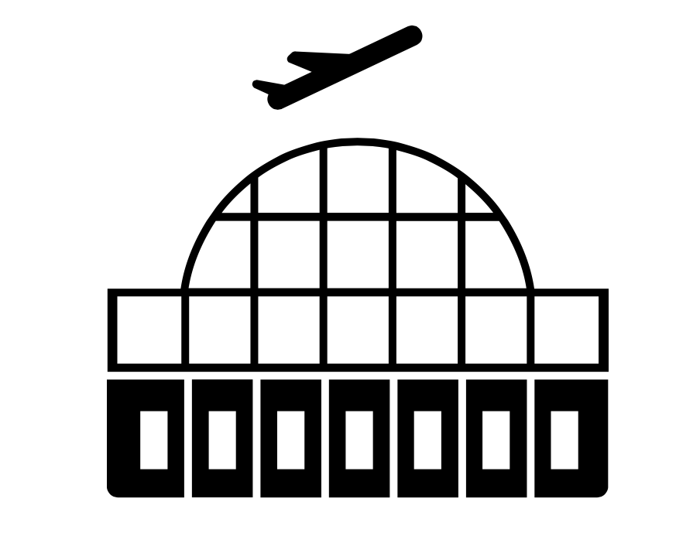


CHICAGO
NEW YORK CITY

Slide 3
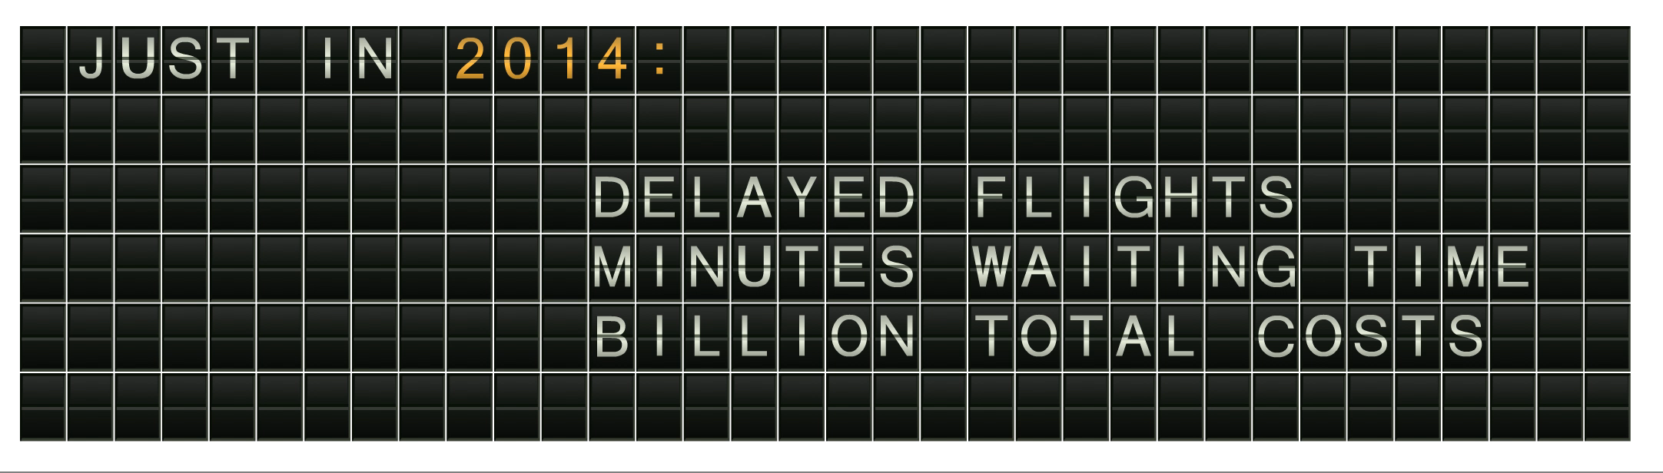





Notes:
Delayed Animation

Slide 4







AIRPORT
AIRLINE
WEATHER
TRAFFIC
REPAIRS
Why is my flight delayed?

Slide 5
AIRPORT
AIRLINE
WEATHER
TRAFFIC
REPAIRS
Why is my flight delayed?

Slide 6
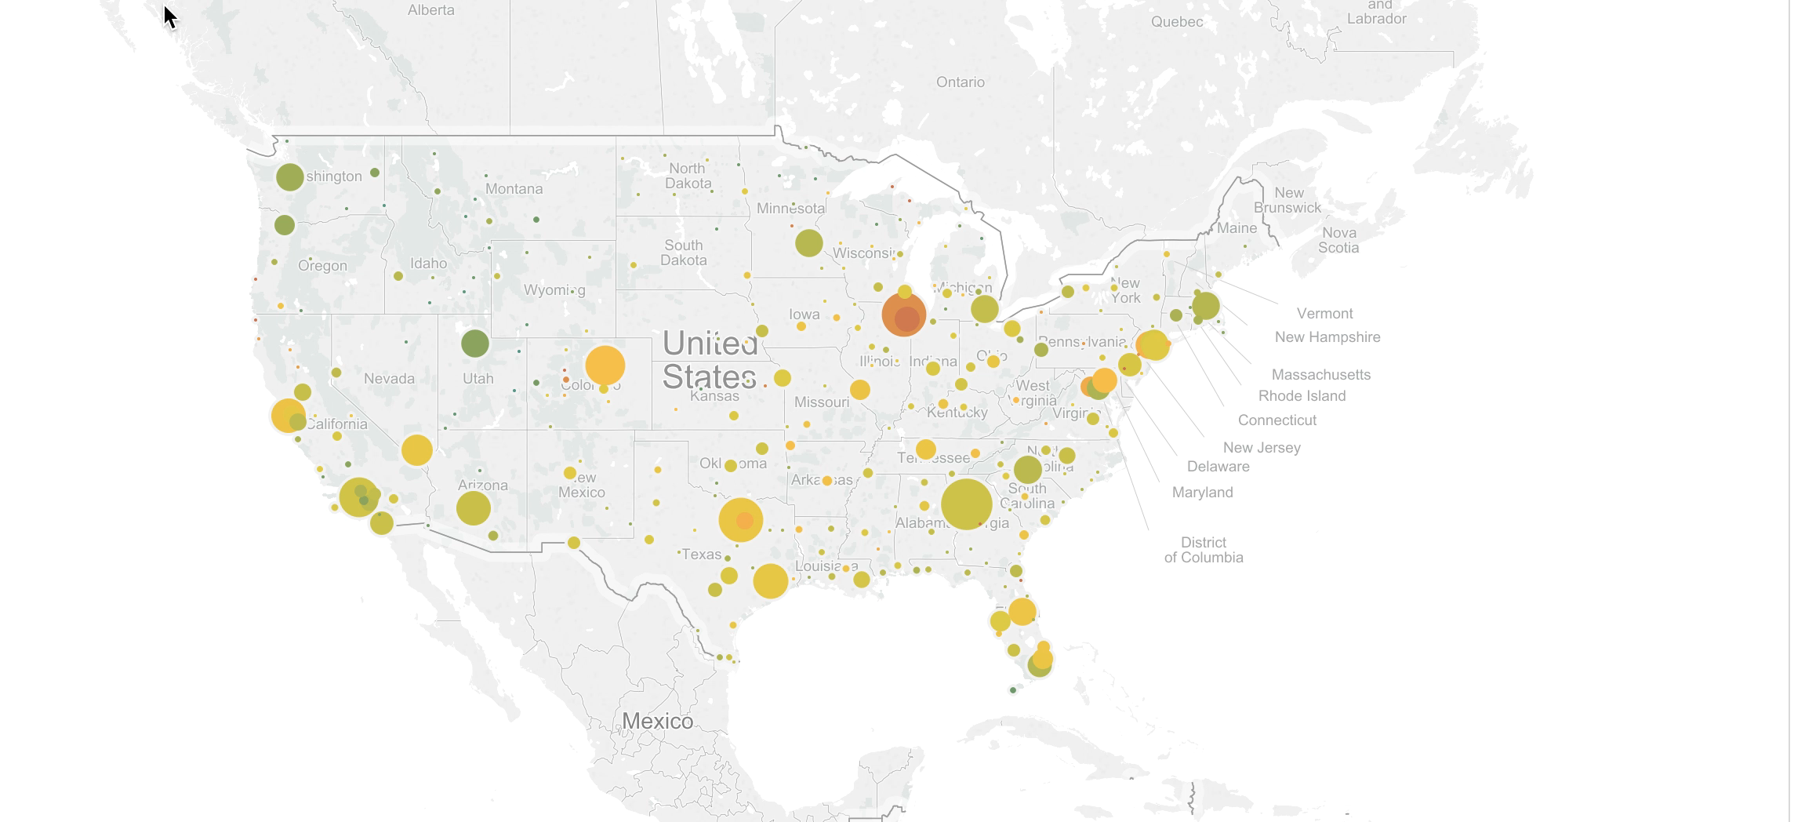

Slide 7
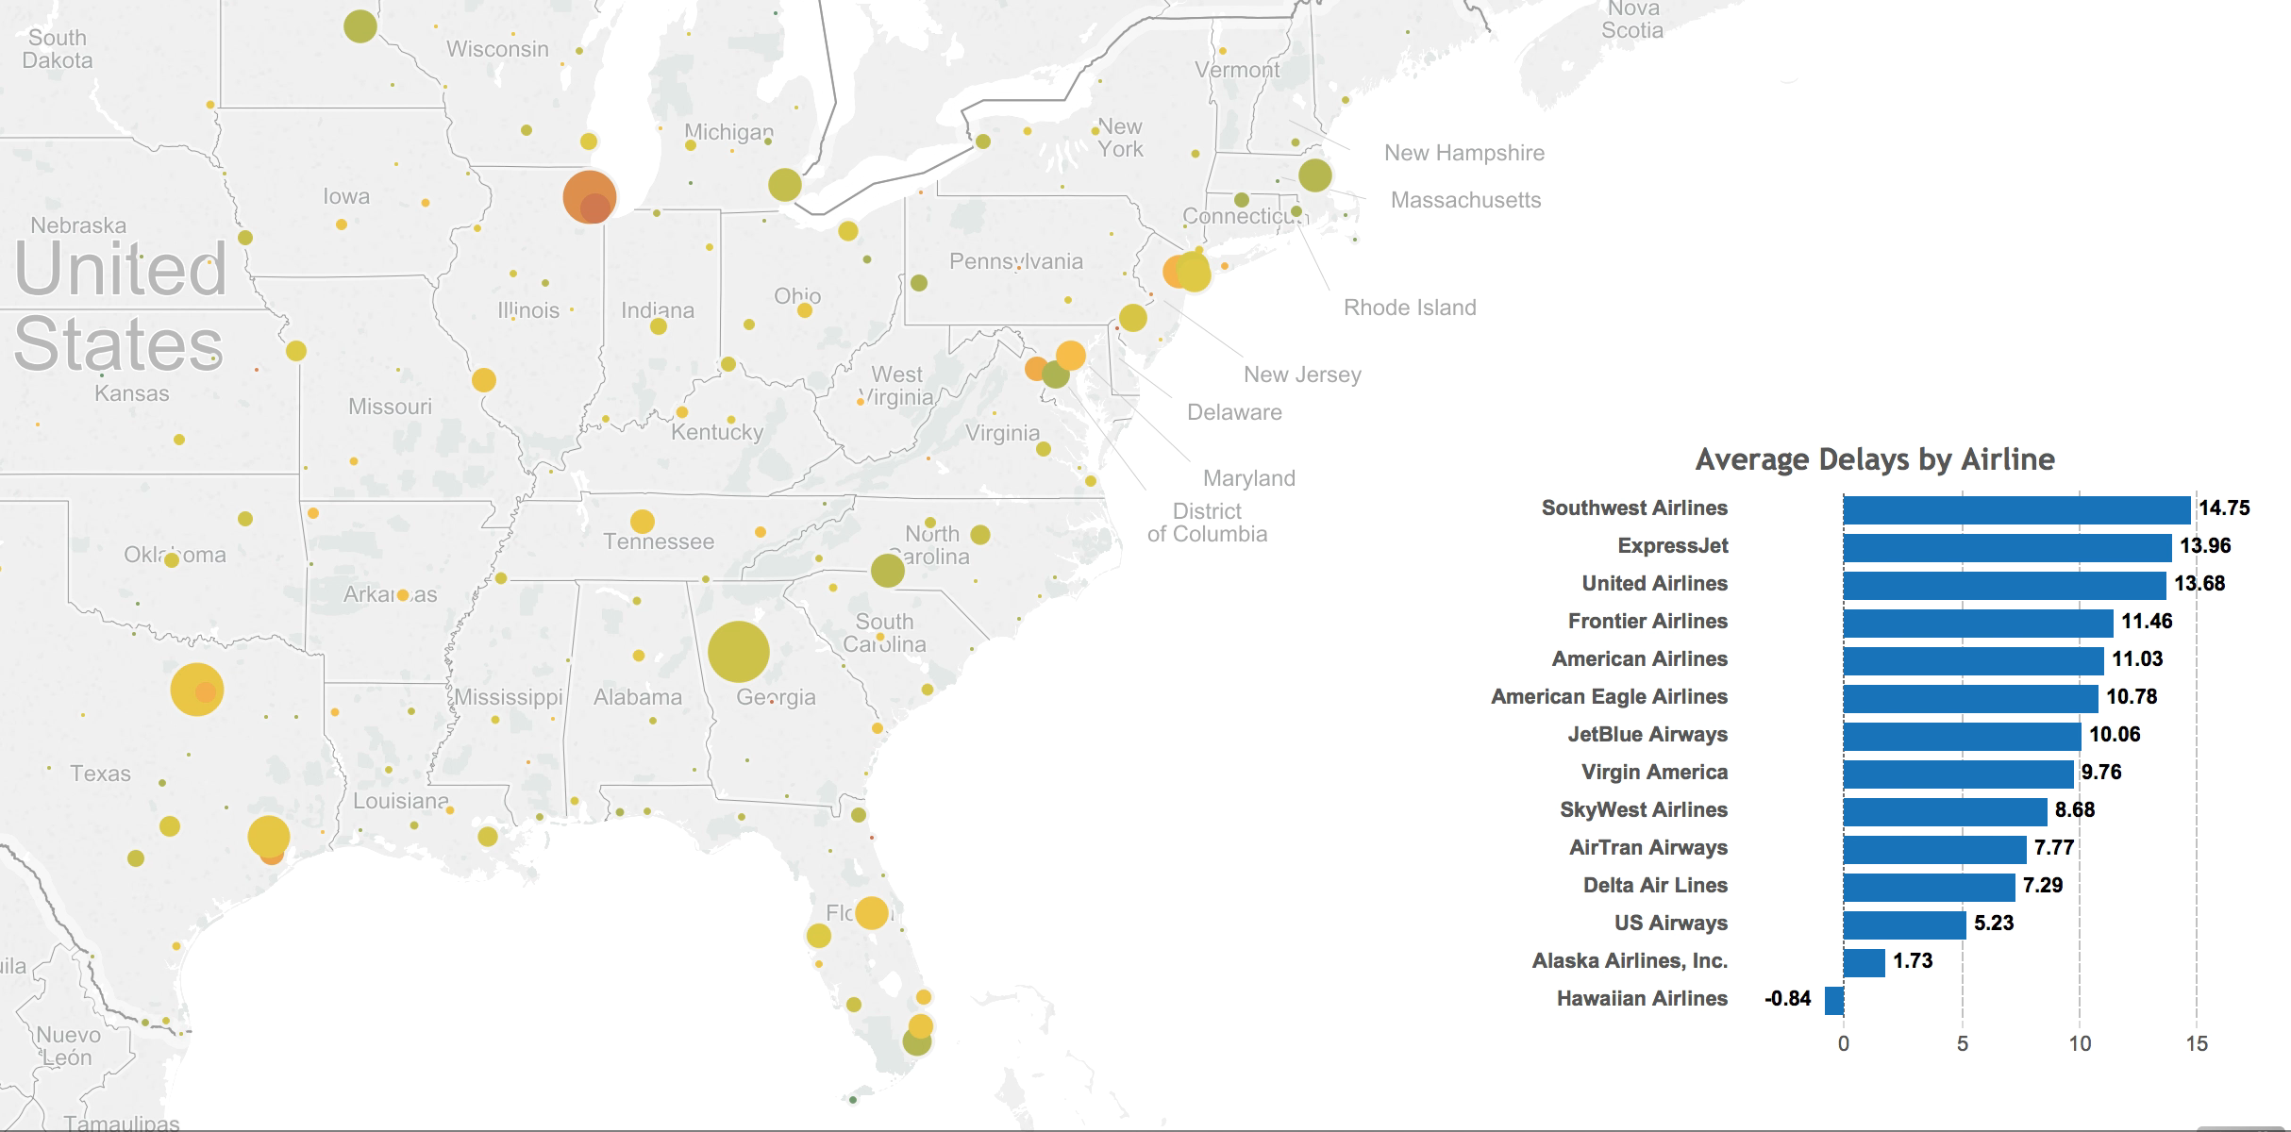

Slide 8

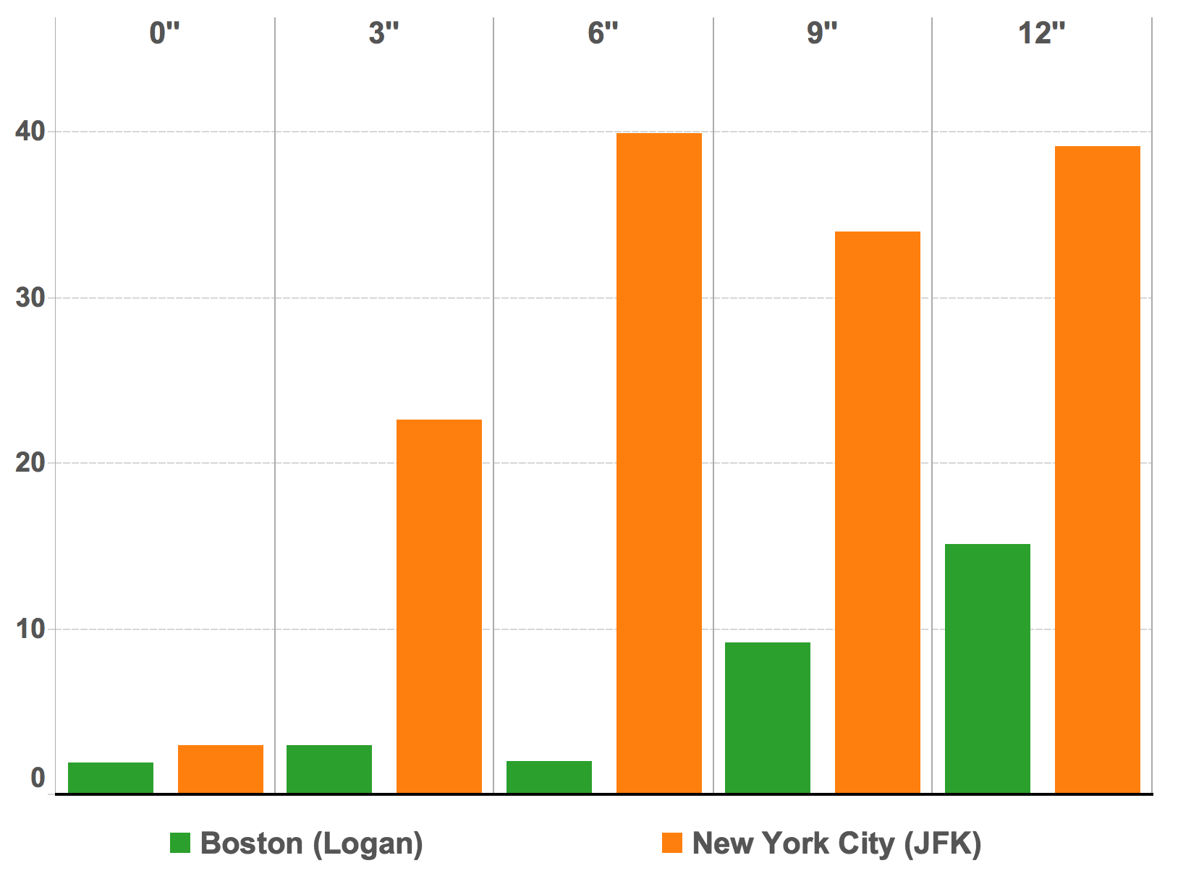


Snow Depth in Inches
Avg.
Weather Delay
(in minutes)

Slide 9
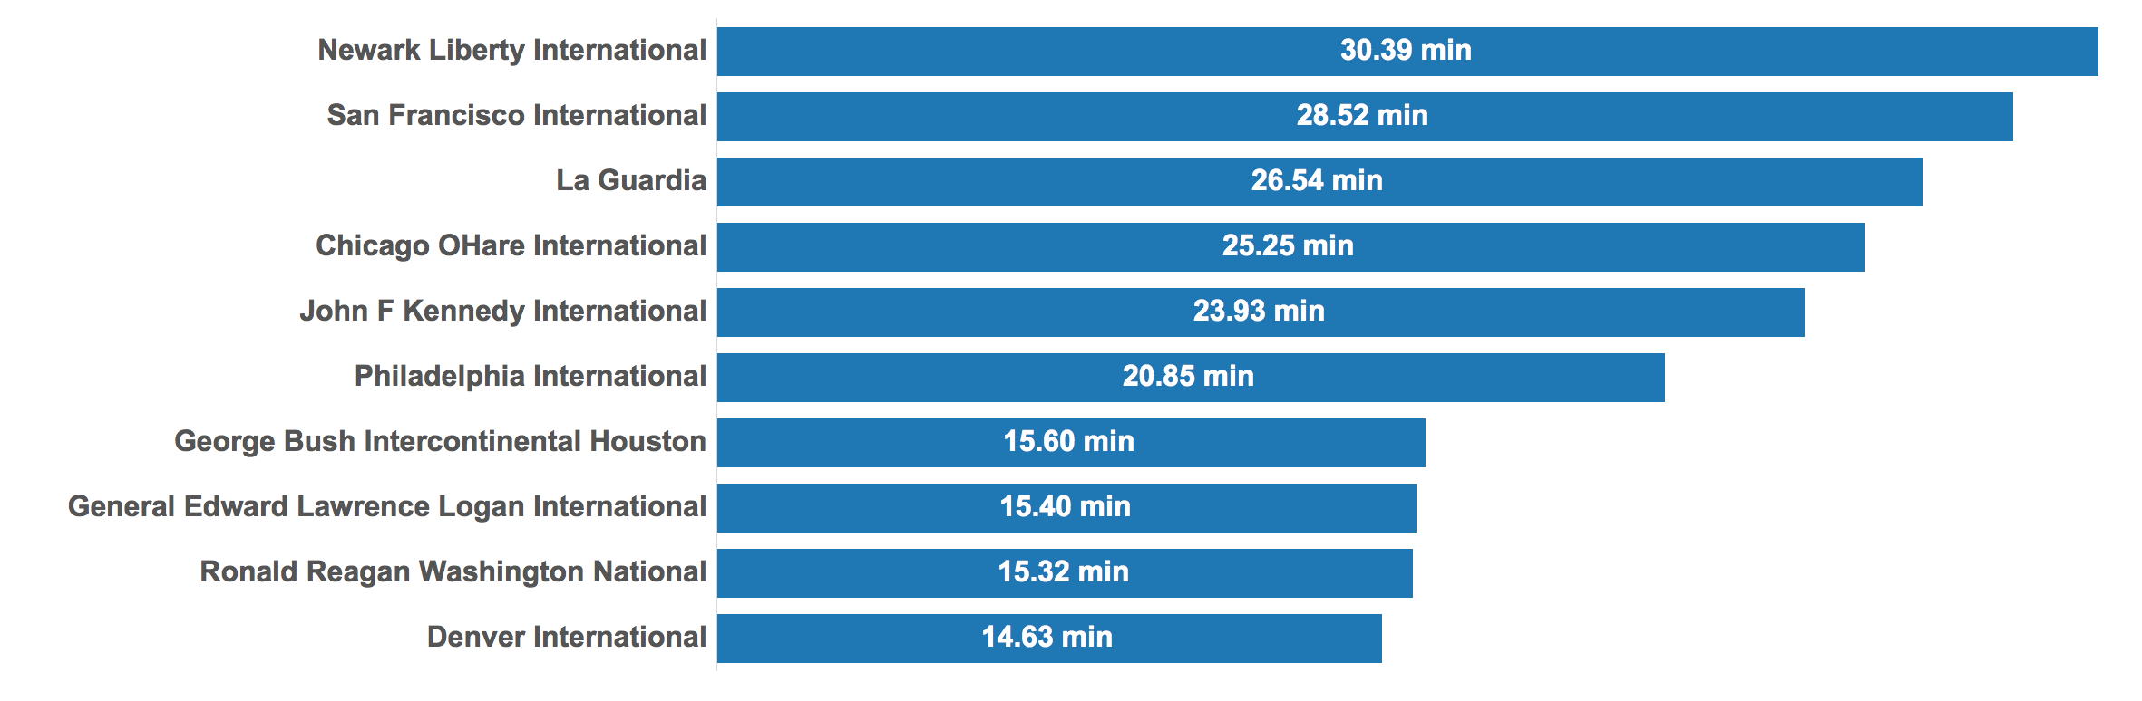

Slide 10
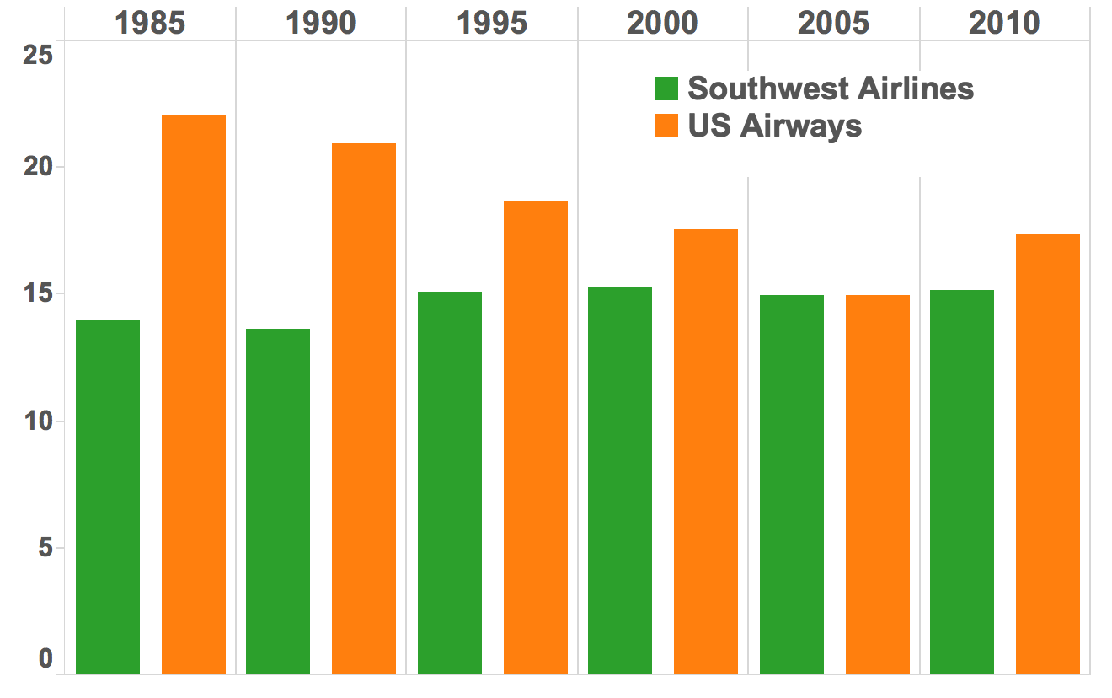
Aircraft Age
Average
Carrier Delay
(in minutes)

Slide 11
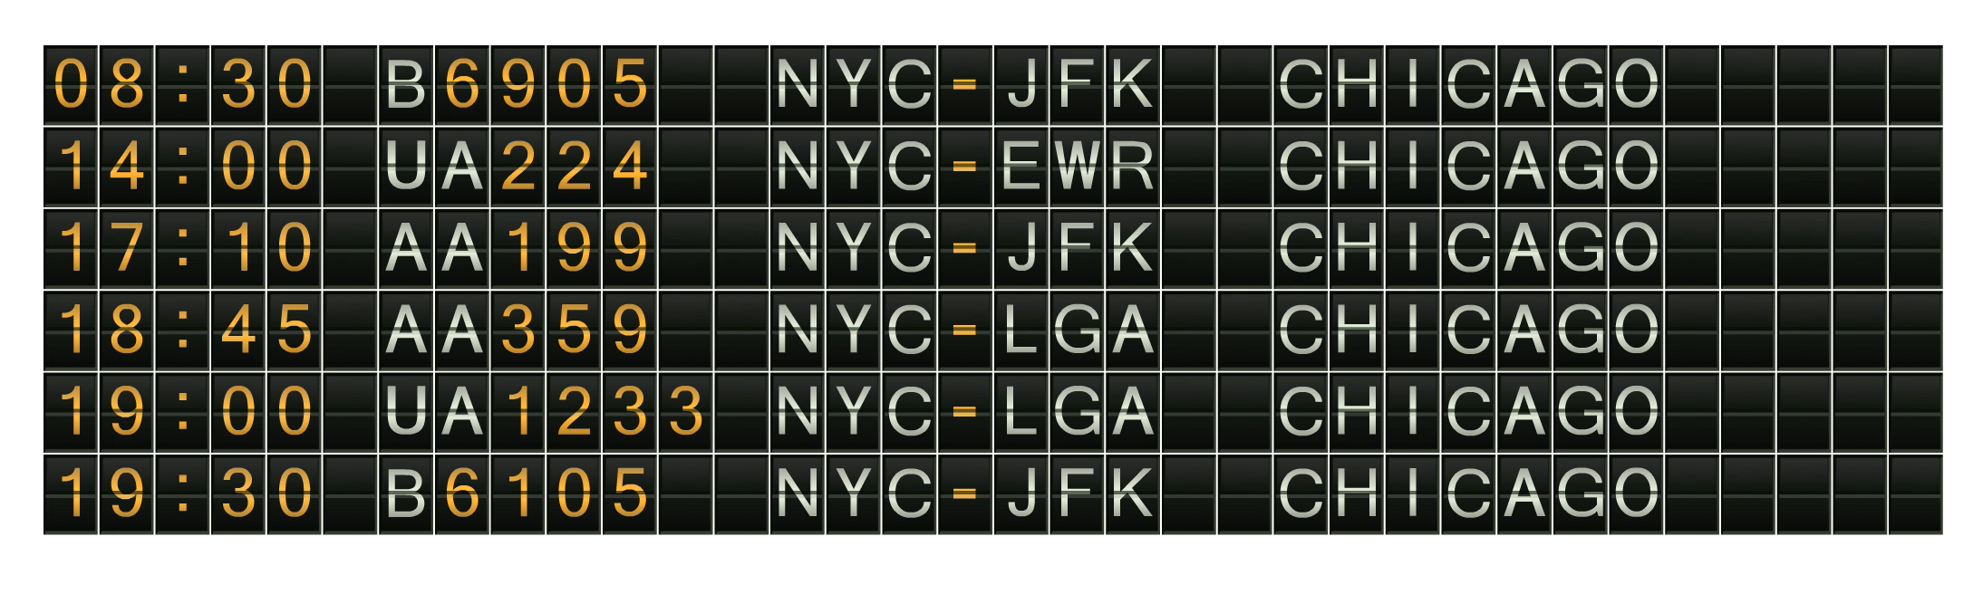

TIME
CODE
ORIGIN
DESTINATION
PRED.
Which flight should I choose?
22
Dec

Slide 12




